Slide 1



visualization sml
View in Power BI
Last data refresh:
9/2/2022 6:49:10 AM UTC
Downloaded at:
9/2/2022 7:01:44 AM UTC

Slide 2
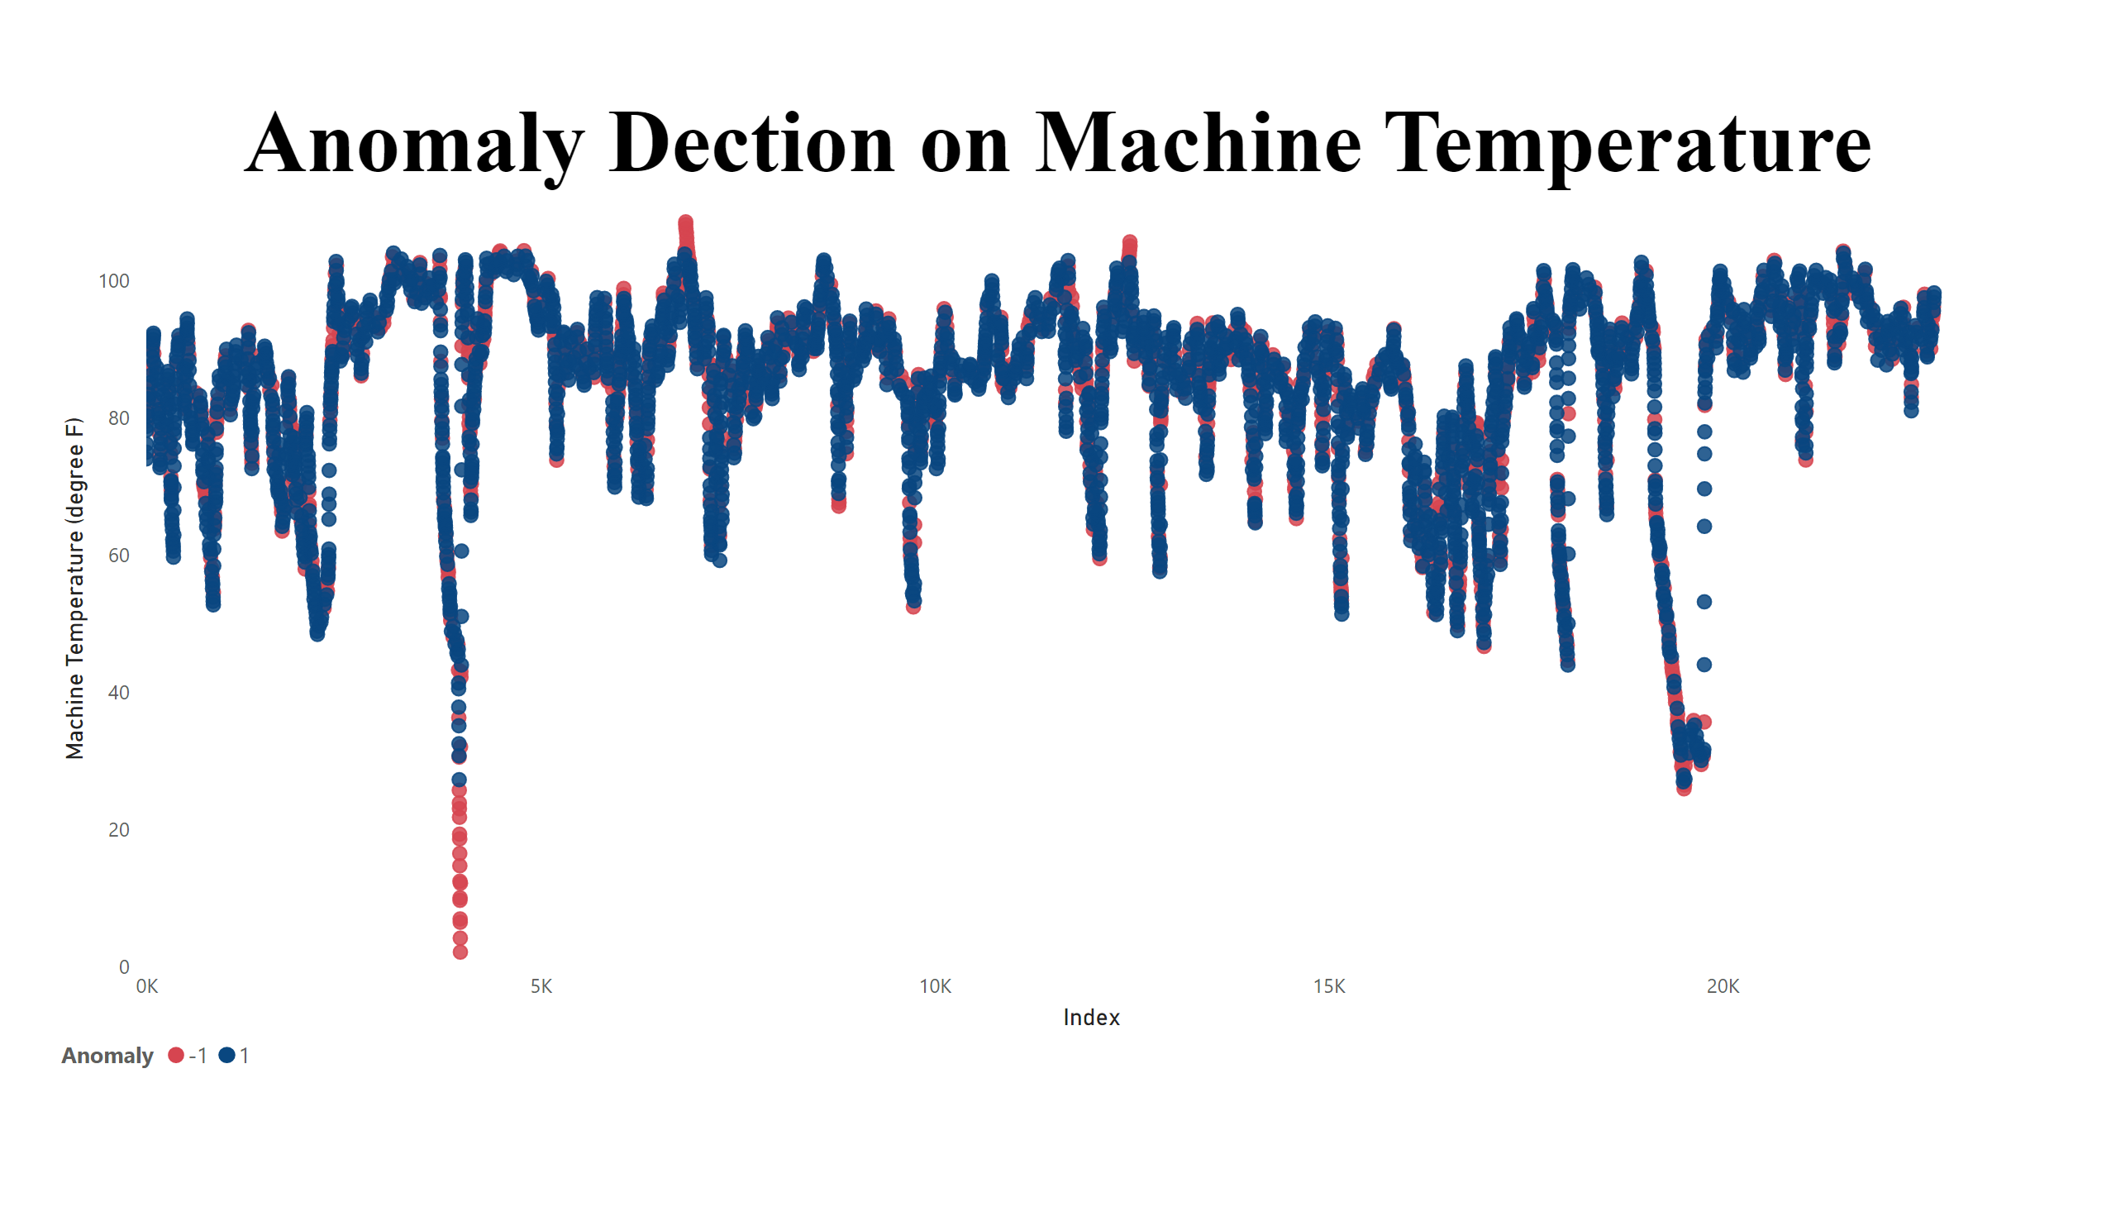
Anomaly detection
Notes:
Anomaly Dection on Machine Temperature
No alt text provided

